Slide 1

重庆大学
C++编程基础及应用
第6章 指针及引用
高等教育出版社 第1版
重庆大学 海洋饼干叔叔
使用WPS播放效果最佳

Slide 2


这个世界是如此的残酷，却又如此的美丽。
——谏山创《进击的巨人》

Slide 3
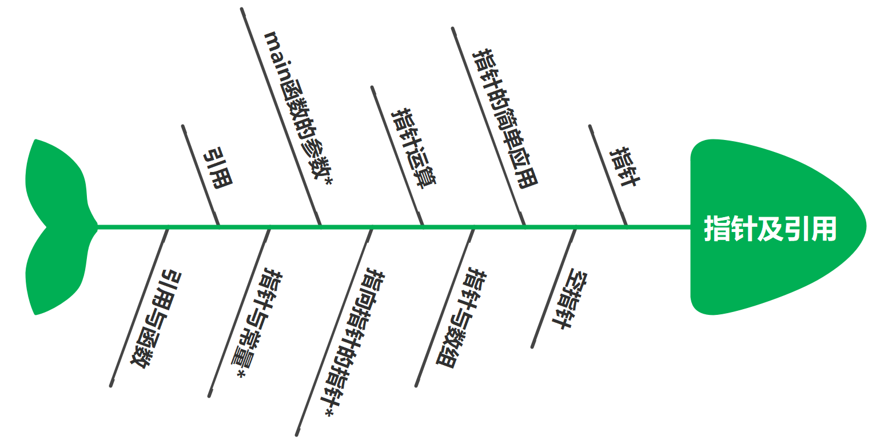
6. 指针及引用

Slide 4

6.1 指针
C++中的指针（pointer）是无数初学者的噩梦，也是造成C++难学难用的原因之一。
int a; //整数对象a
int *p; //指向整数的指针对象p
指针是一个值为内存地址的对象。

Slide 5
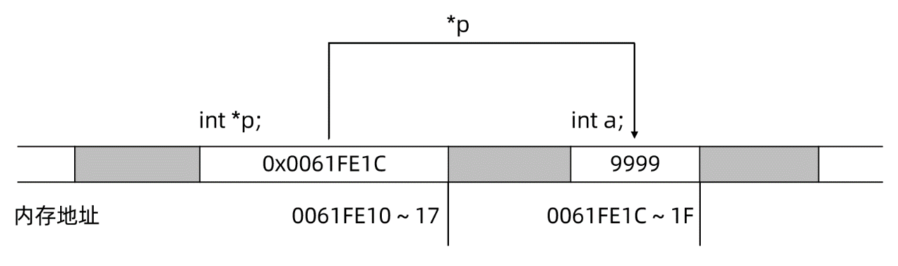
6.1 指针
//Project - PointerBasic
#include <cstdio>
int main(){
int a = 9999, *p;
p = &a;
printf("before: a = %d, *p = %d\n", a, *p);
a++;
*p = *p + 100;
printf("after: a = %d, *p = %d\n", a, *p);
printf("&a = %p, p = %p, sizeof(p) = %lld\n", &a, p, sizeof(p));
printf("&p = %p", &p);
return 0;
}
执行结果
before: a = 9999, *p = 9999 after: a = 10100, *p = 10100 &a = 000000000061FE1C, p = 000000000061FE1C, sizeof(p) = 8 &p = 000000000061FE10

Slide 6
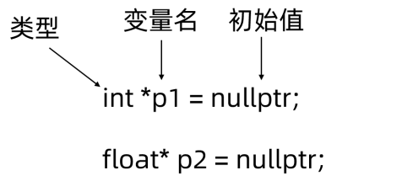
6.1 指针
变量名 | 类型 | 值 | 内存地址
a | int | 9999 | 0x0061FE1C
p | int* | 0x0061FE1C | 0x0061FE10

Slide 7
执行结果
p = nullptr = 0000000000000000 p = &c = 000000000061fe17, c = c, *p = c
6.2 空指针
//Project - NullPtr
#include <iostream>
#include <cstdio>
using namespace std;
int main() {
char c {'c'};
char* p {nullptr};
//*p = 'a'; //对一个空指针应用间接操作符会引发执行错误
printf("p = nullptr = %p\n", p);
p = &c;
printf("p = &c = %p, c = %c, *p = %c", p, c, *p);
return 0;
}
nullptr vs. NULL

Slide 8
6.3 指针的简单应用
//Project - Swap
#include <iostream>
using namespace std;
void swap1(int a, int b){
int t = a;
a = b;
b = t;
}
void swap2(int* a, int* b){
int t = *a;
*a = *b;
*b = t;
}
int main() {
int m = 2, n = 7;
swap1(m,n);
cout << "after swap1: m = " << m << ", n = " << n << endl;
swap2(&m, &n);
cout << "after swap2: m = " << m << ", n = " << n << endl;
return 0;
}
执行结果
after swap1: m = 2, n = 7 after swap2: m = 7, n = 2
call by pointer

Slide 9
执行结果
before function call: &m=0061FE1C,&n=0061FE18,m=2,n=7 before swap in swap1: &a=0061FDE0,&b=0061FDE8,a=2,b=7 after swap in swap1: &a=0061FDE0,&b=0061FDE8,a=7,b=2 after function call: &m=0061FE1C,&n=0061FE18,m=2,n=7
6.3 指针的简单应用
//Project - CallByValue
#include <cstdio>
void swap1(int a, int b){
printf("before swap in swap1: ");
printf("&a=%p,&b=%p,a=%d,b=%d\n", &a, &b, a, b);
int t = a;
a = b;
b = t;
printf("after swap in swap1: ");
printf("&a=%p,&b=%p,a=%d,b=%d\n", &a, &b, a, b);
}
int main() {
int m = 2, n = 7;
printf("before function call: ");
printf("&m=%p,&n=%p,m=%d,n=%d\n", &m, &n, m, n);
swap1(m,n);
printf("after function call: ");
printf("&m=%p,&n=%p,m=%d,n=%d\n", &m, &n, m, n);
return 0;
}
call by value

Slide 10
6.4 指针与数组
//Project - ArrayPointer1
#include <cstdio>
#include <cstdlib>
int main(){
float scores[5] = {55,66,77,88,99};
float* p1 = scores; //把数组名赋值给指针
printf("sizeof(scores) = %lld, sizeof(p1) = %lld\n",sizeof(scores),sizeof(p1));
float* p2 = (float*)malloc(sizeof(float)*5); //申请分配20字节的内存
if (p2==nullptr)
exit(EXIT_FAILURE);
float fSum = 0;
for (unsigned int i=0;i<5;i++){
p2[i] = p1[i]; //指针当成数组用
fSum += p2[i];
}
printf("Average = %f",fSum/5);
free(p2); //释放申请的内存
return 0;
}
执行结果
sizeof(scores) = 20, sizeof(p1) = 8 Average = 77.000000

Slide 11
执行结果
p = 0000009D14A0, p + 1 = 0000009D14A4, p + 3 = 0000009D14AC p[0] = 0.000000, p[3] = 3.000000, p[9] = 9.000000
6.5 指针运算
//Project - PointerOperation1
#include <cstdio>
#include <cstdlib>
int main(){
float* p = (float*)calloc(10,sizeof(float));
if (p==nullptr)
exit(1);
printf("p = %p, p + 1 = %p, p + 3 = %p\n", p, p+1, p+3);
for (int i=0;i<10;i++)
*(p++) = i; //*p++结果相同
p-=10;
printf("p[0] = %f, p[3] = %f, p[9] = %f\n", *p, *(p+3), *(p+9));
free(p); //释放通过calloc()申请的内存
return 0;
}

Slide 12
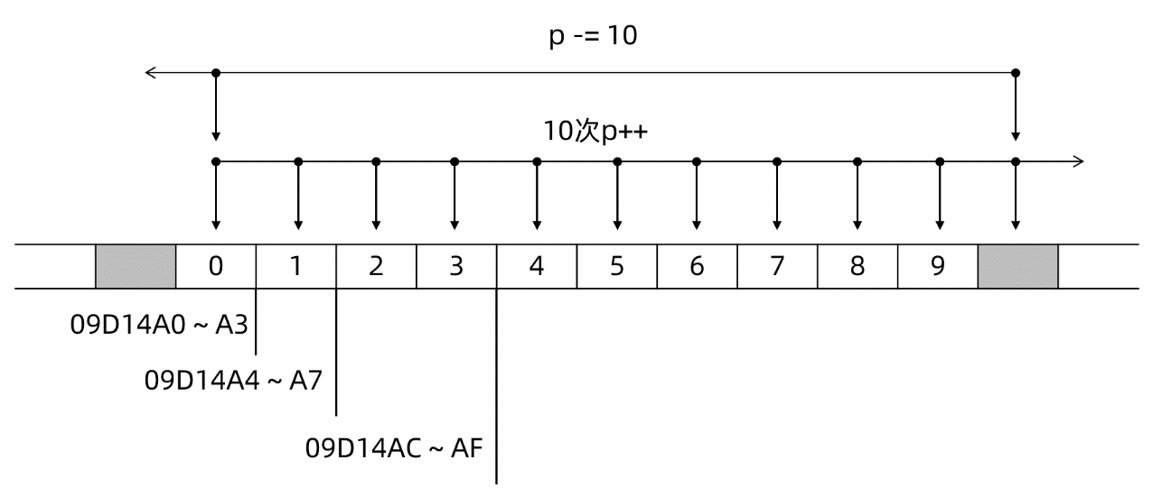

6.5 指针运算
当ElementType*类型的指针p加上整数i时，其结果仍是一个ElementType*类型的指针，该指针的值为：

Slide 13
执行结果
s = MARY HAS 3 LAMBS.
6.5 指针运算
//Project - PointerOperation2
#include <cstdio>
#include <cctype>
int main() {
char s[] = "Mary has 3 lambs.";
char* p = s;
while (*p!=0){ //*p!=0 等价于 (*p)!=0
if (islower(*p))
*p = *p + ('A' - 'a');
p++;
}
printf("s = %s",s);
return 0;
}

Slide 14
执行结果
&a = 000000000061FE1C, p = 000000000061FE1C &p = 000000000061FE10, pp = 000000000061FE10 &pp = 000000000061FE08 before: a = 100, *p = 100, **pp = 100 after: a = 103, *p = 103, **pp = 103
6.6 指向指针的指针*
//Project - Pointer2Pointer
#include <cstdio>
int main(){
int a = 100;
int *p = &a;
int **pp = &p;
printf("&a = %p, p = %p\n", &a, p); //p的值为a的地址
printf("&p = %p, pp = %p\n", &p, pp); //pp的值为p的地址
printf("&pp = %p\n", &pp);
printf("before: a = %d, *p = %d, **pp = %d\n", a, *p, **pp);
a++;
(*p)++;
**pp = **pp + 1;
printf("after: a = %d, *p = %d, **pp = %d\n", a, *p, **pp);
return 0;
}

Slide 15
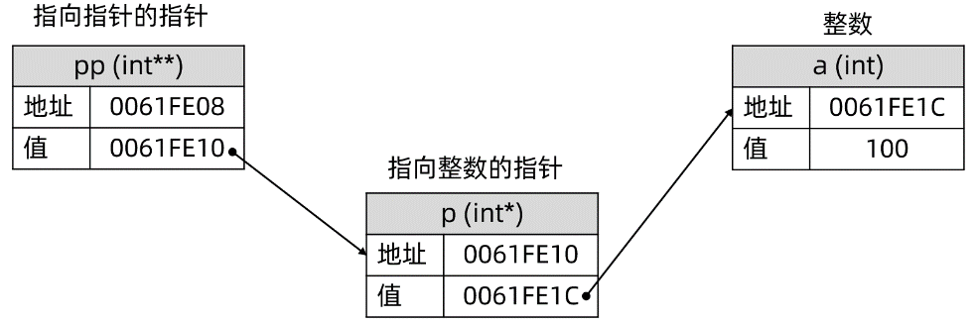
6.6 指向指针的指针*

Slide 16
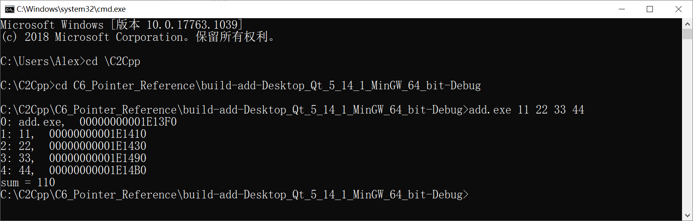

6.7 main函数的参数*
经由操作系统，用户可以为应用程序的运行指定额外参数，进而影响应用程序的行为。对于C++程序而言，经由操作系统提供的运行参数可由main()函数获取并处理。
main参数

Slide 17
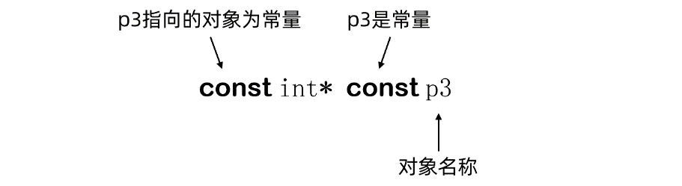
6.8 指针与常量*
指针与常量

Slide 18
6.9 引用
执行结果
&iRabbits = 000000000061fe14, &iBunnies = 000000000061fe14 iRabbits = 115, iBunnies = 115
//Project - BasicRef
#include <iostream>
#include <cstdio>
using namespace std;
int main() {
int iRabbits = 100;
int& iBunnies = iRabbits;
printf("&iRabbits = %p, &iBunnies = %p\n", &iRabbits, &iBunnies);
iRabbits += 10;
iBunnies += 5;
cout << "iRabbits = " << iRabbits << ", iBunnies = " << iBunnies << endl;
return 0;
}
引用必须在定义时与其它对象绑定，且不能通过赋值改变绑定关系。
引用的实质是自解析的指针。

Slide 19
执行结果
&m = 000000000061fe1c, &n = 000000000061fe18 &a = 000000000061fe1c, &b = 000000000061fe18 after swap1: m = 9.9, n = 1.1
6.10 引用与函数
//Project - RefFunc
#include <iostream>
#include <cstdio>
using namespace std;
void swap1(float& a, float& b){
printf("&a = %p, &b = %p\n", &a, &b);
float t = a;
a = b;
b = t;
}
int main() {
float m = 1.1f, n = 9.9f;
printf("&m = %p, &n = %p\n", &m, &n);
swap1(m,n);
cout << "after swap1: m = " << m << ", n = " << n;
return 0;
}
call by reference
call by value
call by pointer

Slide 20
End of Chapter 6
重庆大学 海洋饼干叔叔

